Slide 1




Formal Verification of Health Assessment Tools: a Case Study
Jonas S. Bezerra, Andrei Costa,
Profª. Drª. Leila Ribeiro, Profª. Drª. Érika Cota

Slide 2

Motivation
Health Assessment Tools

Slide 3
Motivation
Health Assessment Tools
Software Specification

Slide 4
Motivation
Health Assessment Tools
Software Specification
Specifications in Natural Language

Slide 5

Motivation
Natural Language Communication Problems

Slide 6

Motivation
Natural Language Communication Problems
Ambiguity

Slide 7
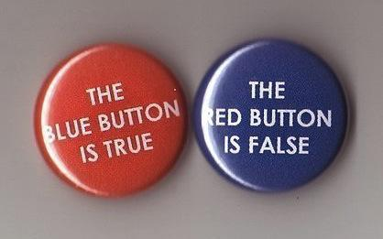
Motivation
Natural Language Communication Problems
Ambiguity
Inconsistencies

Slide 8
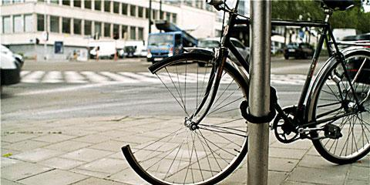
Motivation
Natural Language Communication Problems
Ambiguity
Inconsistencies
Omissions

Slide 9

How to solve or eliminate this problems?

Slide 10

Formal Verification Methodology
Graph Transformations
Identification of entities
Identification of actions
Characterization of conditions and effects as states
Construction of Type Graph
Construction of Rules
Analysis

Slide 11
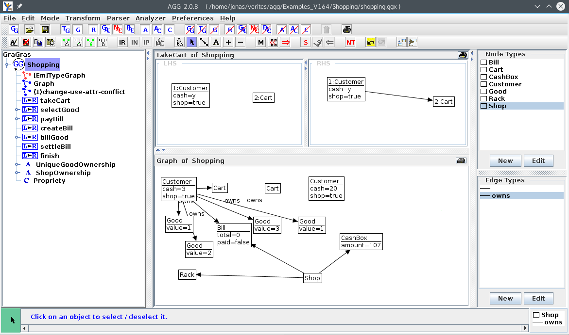

AGG: The Attributed Graph Grammar System

Slide 12
Case Study - Leishmaniasis treatment guideline
Applying medication
Preconditions:
Patient attends to criteria.
Lesion area is known.
Postconditions:
Patient under medication.

Slide 13
Case Study - Leishmaniasis treatment guideline
Main Scenario
MD calculates the total volume of medicine to be injected.
MD calculates 1/4 of medicine volume.
MD puts Lidocaine 2% in a 5ml syringe with insuline needle.
MD injects Lidocaine in the 4 lesion compass points until 4 3mm² anaesthetic buttons have formed.
MD aspirates the contents of the Glucantime ampola (5ml) using a 5ml syringe and 25x0.7G needle.
MD discards the needle used in the medication aspiration.
MD couples another 25x0.7G needle in the syringe with medication.
MD inserts the needle in the anaesthetic button in the direction of the center of the lesion with the bevel facing upwards.
MD retracts the needle towards the border of the lesion and at the same time injects 1/4 of the estimated volume of medication.
MD repeats steps 8 and 9 in the 3 remaining anaesthetic buttons.
MD observes whether edema have formed and ends the procedure.

Slide 14
Step 1: Identification of Entities
Patient
Criteria
Area of injury
Medication
Medicine
Doctor
Medicine volume
Estimated medicine volume
Lidocaine 2%
5ml Syringe
Insulin needle
Cardinal Point(s) of Injury
Anesthetics buttons
5ml ampoule of Glucantime
Glucantime
25 x 0.7G needle
Center of Injury
Bevel
Swelling/Edema
Saturation of injury.

Slide 15

Step 1: Identification of Entities

Slide 16



Step 1: Identification of Entities

Slide 17
Step 2: Identification of Actions
calculateVolume
divideVolume
aspireLidocaine
injectLidocaine
aspirateGlucantime
discardNeedle
coupleNewNeedle
coupleNewNeedle
insertNeedleInAnaestheticsButtonsadministerGlucantime
observeSaturatedInjury
observeNotSaturatedInjury
administerMoreGlucantime

Slide 18
Step 2: Identification of Actions
Action | Conditions | Effects
calculateVolume | The area of the injury is known Patient meets criteria | MD knows the estimated volume of the medicine
... | ... | ...

Slide 19
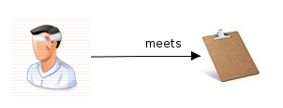
Step 3: Characterization of conditions and effects
Patient meets criteria

Slide 20
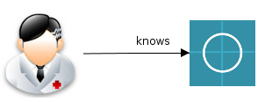
Step 3: Characterization of conditions and effects
Patient meets criteria
The area of the injury is known

Slide 21
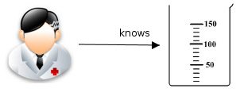
Step 3: Characterization of conditions and effects
Patient meets criteria
The area of the injury is known
MD knows the estimated volume of the medicine

Slide 22
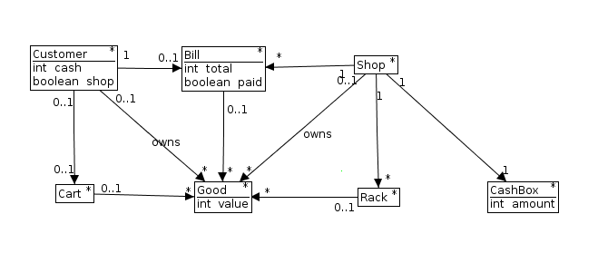
Step 4: Construction of Type Graph

Slide 23
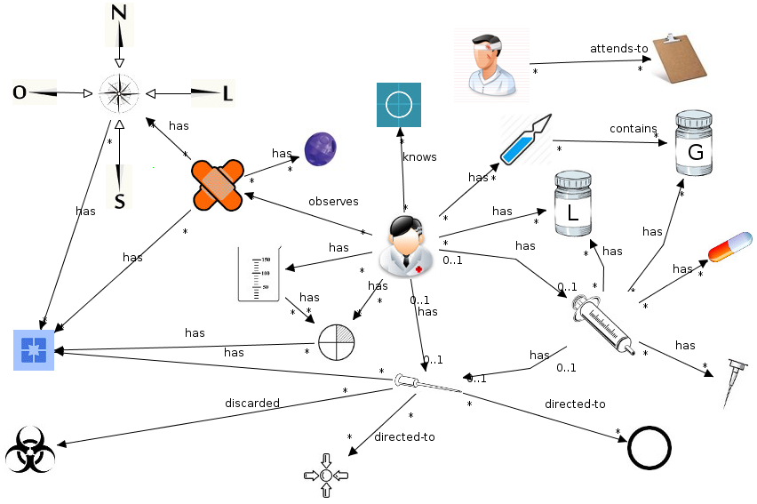
Step 4: Construction of Type Graph

Slide 24
Step 5: Construction of rules
Left Hand Side (LHS): the conditions that must be true for this action to occur.
Right Hand Side (RHS) represents the result of the rule application.

Slide 25
Step 5: Construction of rules
Left Hand Side (LHS): the conditions that must be true for this action to occur.
Right Hand Side (RHS) represents the result of the rule application.
Effects of Rule Application
items in the LHS that do not appear in the RHS are deleted
items in the LHS that appear in RHS are preserved
items in the RHS that do not appear in the LHS are created

Slide 26
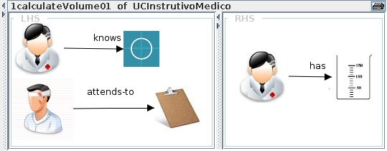
Step 5: Construction of rules

Slide 27
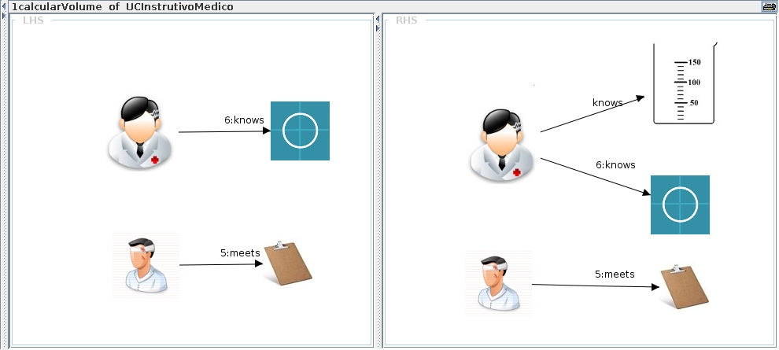
Step 5: Construction of rules

Slide 28
Step 5: Construction of rules
Negative Application Condition NAC
Specify a forbidden context for rule application:
The LHS is copied
The forbidden elements are added to it.

Slide 29
Step 5: Construction of rules

Slide 30
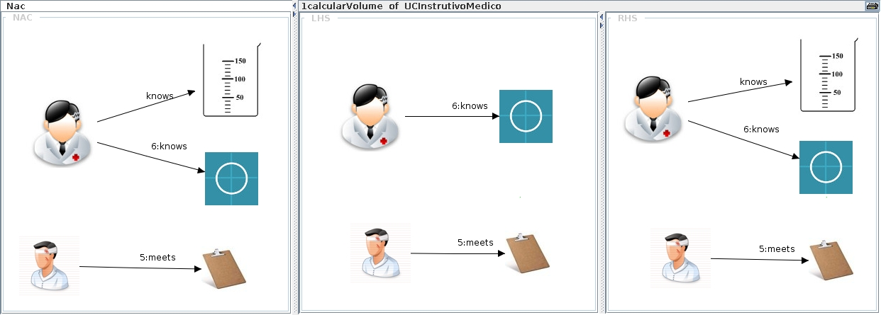
Step 5: Construction of rules

Slide 31
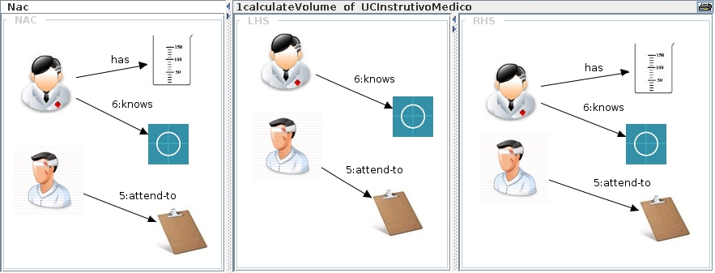
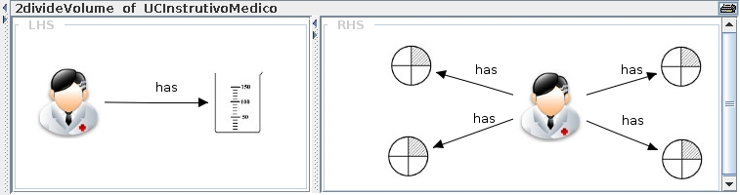
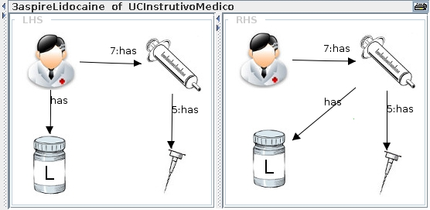
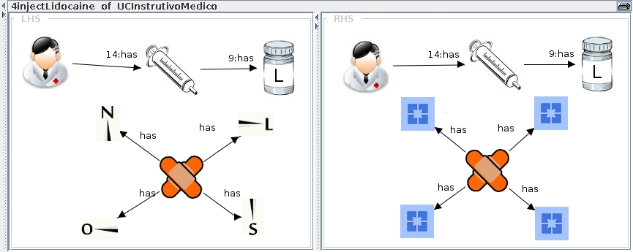
Step 5: Construction of rules

Slide 32
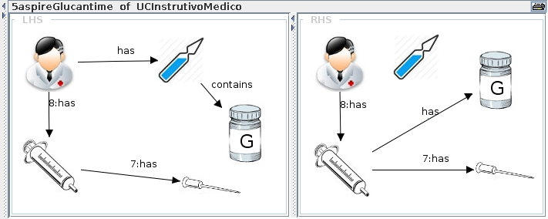
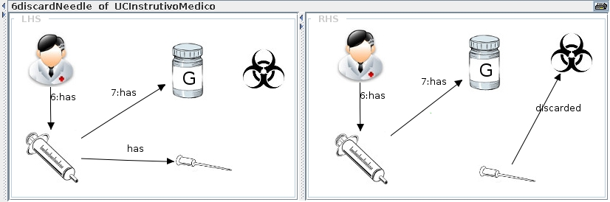
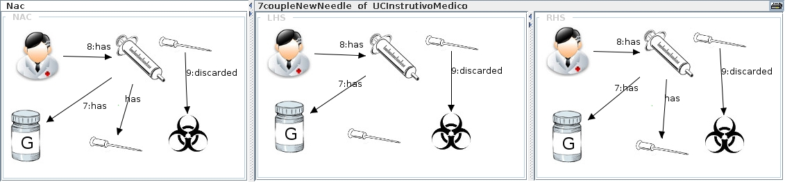
Step 5: Construction of rules

Slide 33
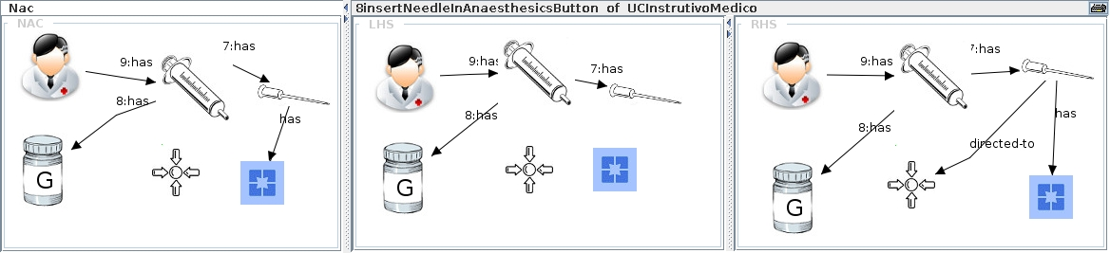
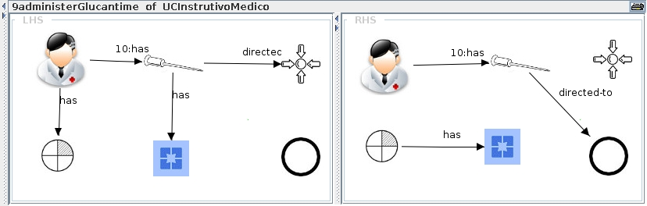
Step 5: Construction of rules

Slide 34
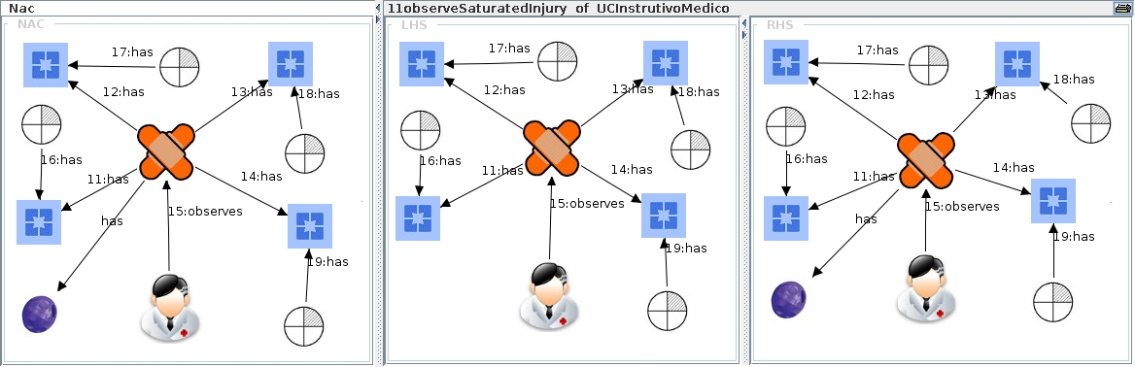
Step 5: Construction of rules

Slide 35
Step 6: Analysis
Conflict Analysis
Dependency Analysis
Concurrent Rule

Slide 36
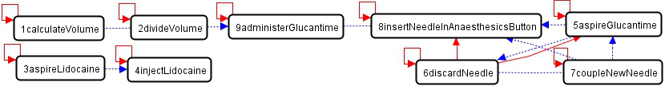
Step 6: Analysis

Slide 37
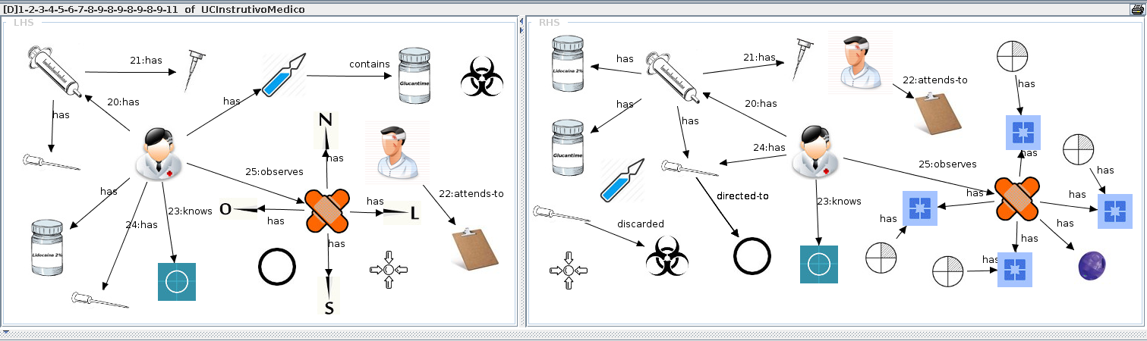
Step 6: Analysis

Slide 38
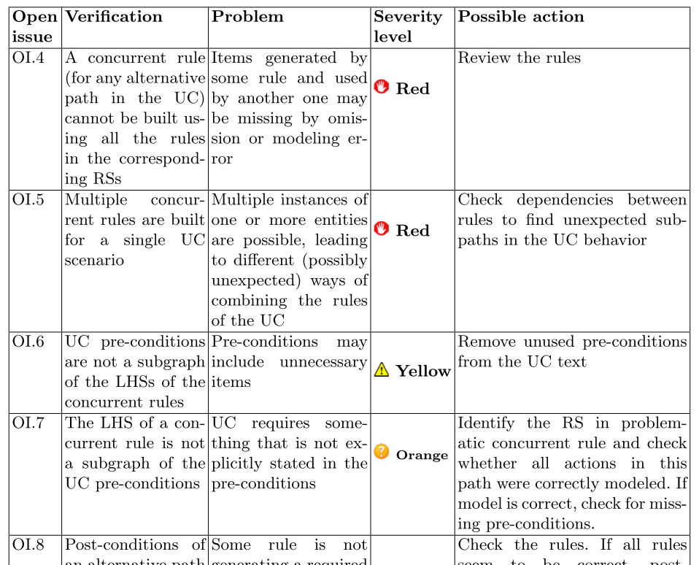
Step 6: Analysis

Slide 39
Results
13 open issues found:
3 synonyms misuse
4 weak pre-conditions
2 weak post-conditions
4 step rewrites

Slide 40
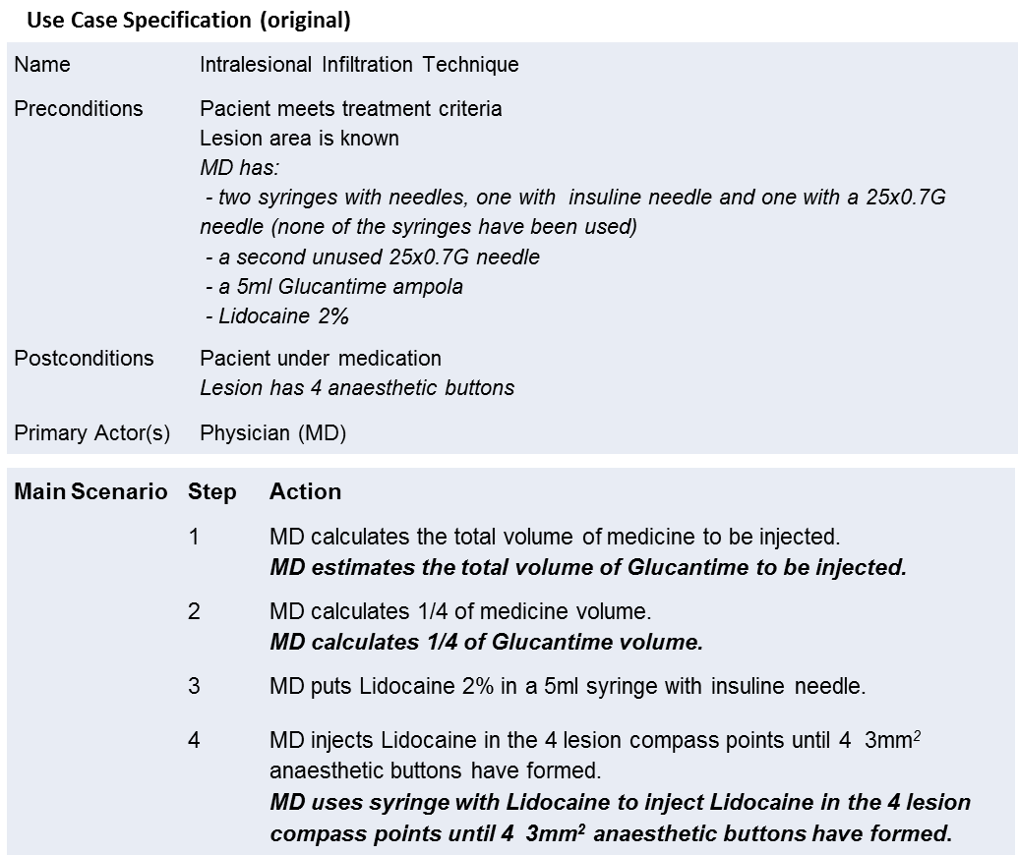
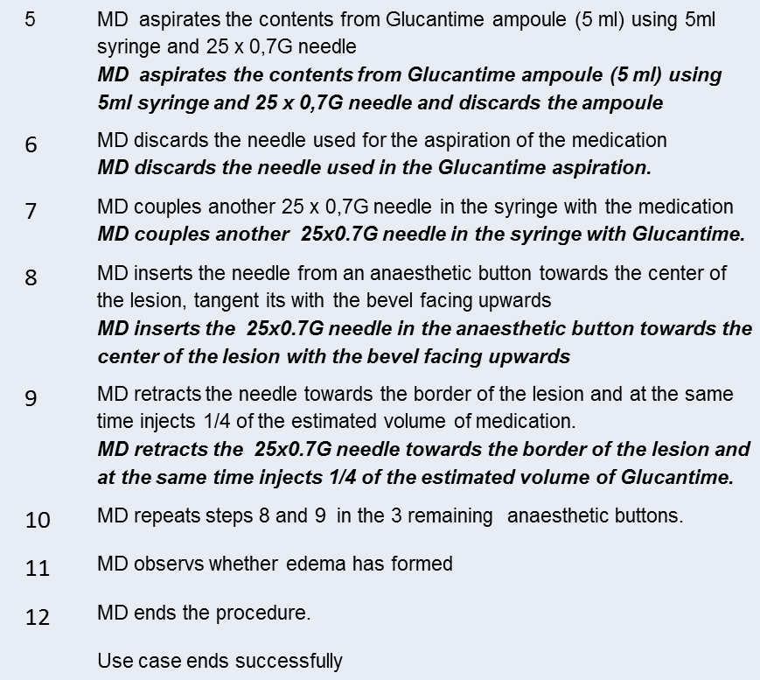
Results

Slide 41
Results

Slide 42
Final Remarks
Systematic way to improvement specifications in Natural Language
General Applicability
Towards an Automatization

Slide 43
Acknowledgement
Dr. Gláucia Cota from Centro de Pesquisas René Rachou (Fiocruz-MG)

Slide 44
Contact
Jonas S. Bezerra: jsbezerra@inf.ufrgs.br
Andrei Costa: acosta@inf.ufrgs.br
Profª. Drª. Leila Ribeiro: leila@inf.ufrgs.br
Profª. Drª. Érika Cota: erika@inf.ufrgs.br

Slide 45


